Slide 1
ANDROID Basic User Interface: Layouts Overview

Slide 2
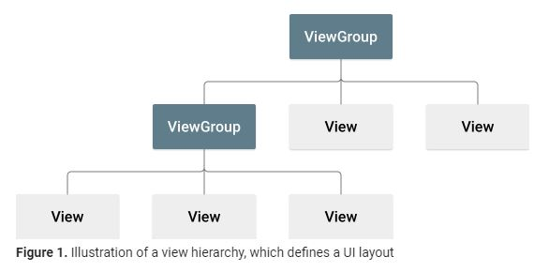
Layout: ViewGroups and Views
A Layout defines the structure for a user interface in your app, such as in an activity.
All user interface elements in an Android app are built using View and ViewGroup objects.
A View is an object that draws something on the screen that the user can interact with. – Examples: buttons and text fields
A ViewGroup is an object or invisible container that holds other View (and ViewGroup) objects in order to define the layout of the interface. – Examples: linear, relative or constraint layout

Slide 3
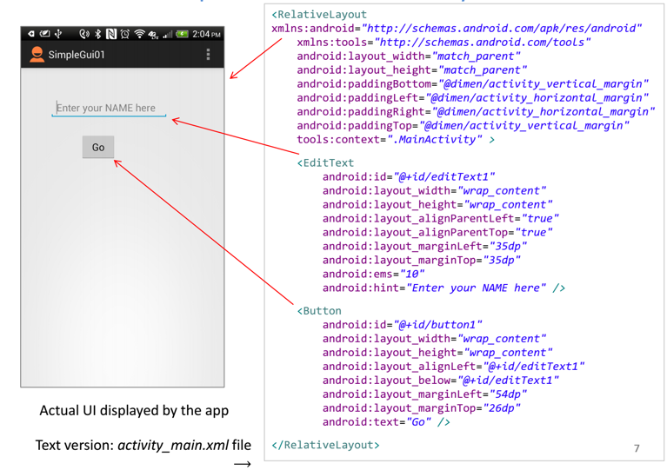
Graphical UI to XML Layout
Each Screen in your app will likely have an xml layout file describes the container and widgets on the screen / UI
Edit XML file or use drag and drop editor
Alter container and layout attributes for the set up you want
We can access and manipulate the container and widgets in our Java code associated with the UI / screen.

Slide 4
ViewGroup Types
Linear Layout: A view group that aligns all children in a single direction, vertically or horizontally.
Relative Layout: A view group that displays child views in relative positions.
Constraint Layout: A view group where child views can be positioned in adaptable and flexible ways
Table Layout: A view group that groups views into rows and columns.
Absolute Layout: A view group enables you to specify the exact location of its children.
Frame Layout: The FrameLayout is a placeholder on screen that you can use to display a single view.
Motion Layout: A view group that manages view motion and widget animations.
Coordinator Layout: A view group that enables views to inherit the attributes of the underlying view.
List View: ListView is a view group that displays a list of scrollable items.
Grid View: GridView is a ViewGroup that displays items in a two-dimensional, scrollable grid.
Adapter View: AdapterView is a ViewGroup that displays items loaded into an adapter.

Slide 5
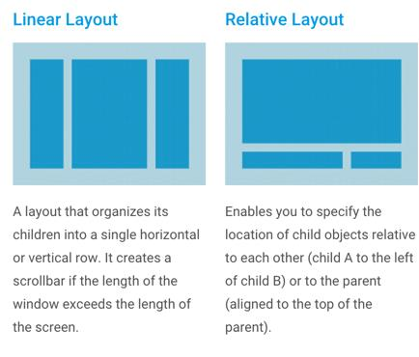
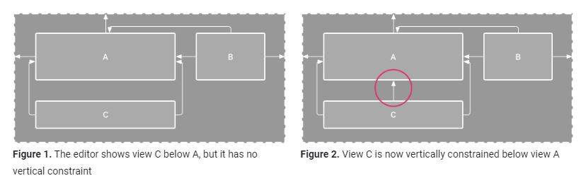
Common Layouts
Constraint Layout

Slide 6
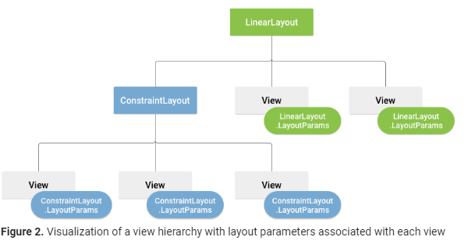
Layout Attributes & Parameters
android:id - This is the ID which uniquely identifies the view.
android:layout_width - This is the width of the layout.
android:layout_height - This is the height of the layout
android:layout_marginTop - This is the extra space on the top side of the layout.
android:layout_marginBottom - This is the extra space on the bottom side of the layout.
android:layout_marginLeft - This is the extra space on the left side of the layout.
android:layout_marginRight - This is the extra space on the right side of the layout.
android:layout_gravity - This specifies how child Views are positioned.
android:layout_weight - This specifies how much of the extra space in the layout should be allocated to the View.
Layout attributes define layout parameters for the View that are appropriate for the ViewGroup in which it resides.

Slide 7
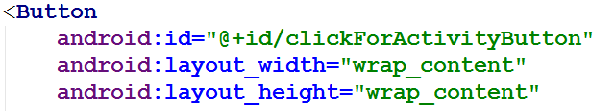
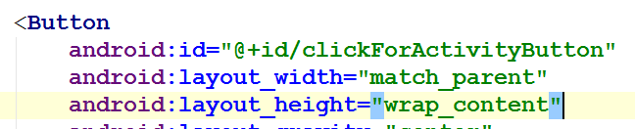
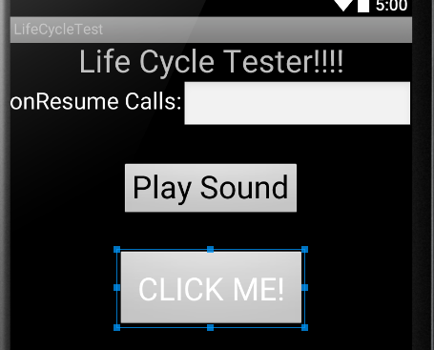
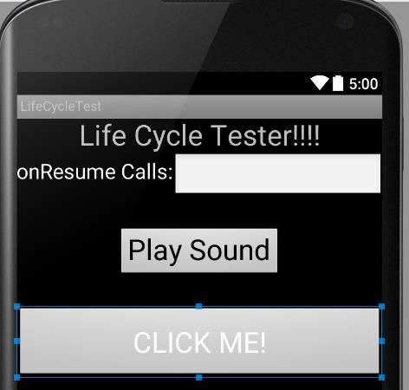
Layout Attributes: Size
Three types:
Specified (hard coded) size in dp (density independent pixels), sp (scale independent pixel) etc.
wrap_content – tells your view to size itself to the dimensions required by its content.
match_parent – tells your view to become as big as its parent view group will allow.

Slide 8
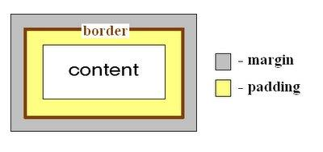
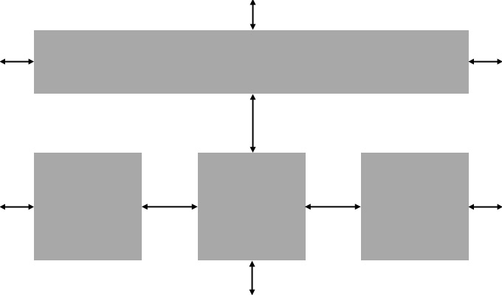
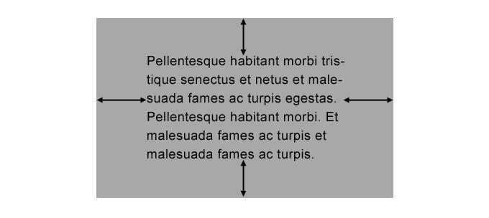
Layout Attributes: Margin & Padding
Margins are the spaces outside the border, between the border and the other elements next to this view.
Controlled by android:layout_margin property.
Padding is the space inside the border, between the border and the actual view's content.
Controlled by android:padding property.
Button
Margin
Padding

Slide 9
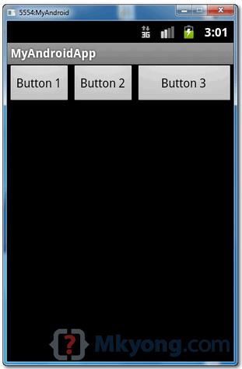
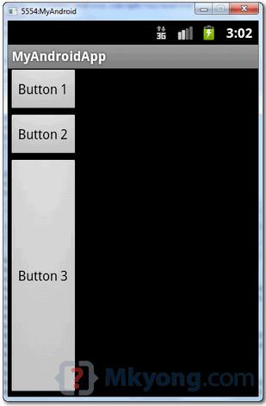
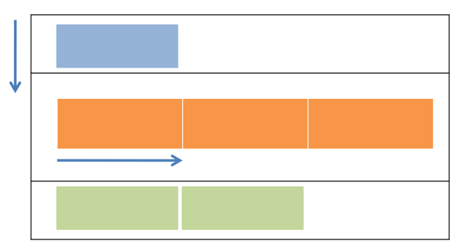
Linear Layout
Supports a filling strategy in which new elements are stacked either in a horizontal or vertical fashion.
If the layout has a vertical orientation new rows are placed one on top of the other.
A horizontal layout uses a side by-side column placement policy.
Horizontal
Vertical

Slide 10
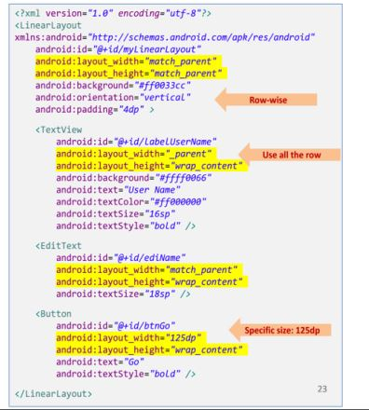
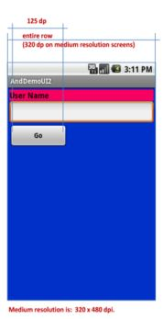
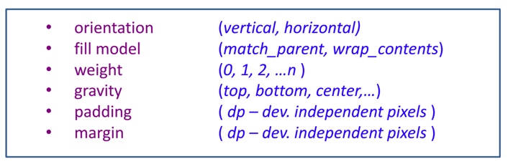
Linear Layout Attributes

Slide 11
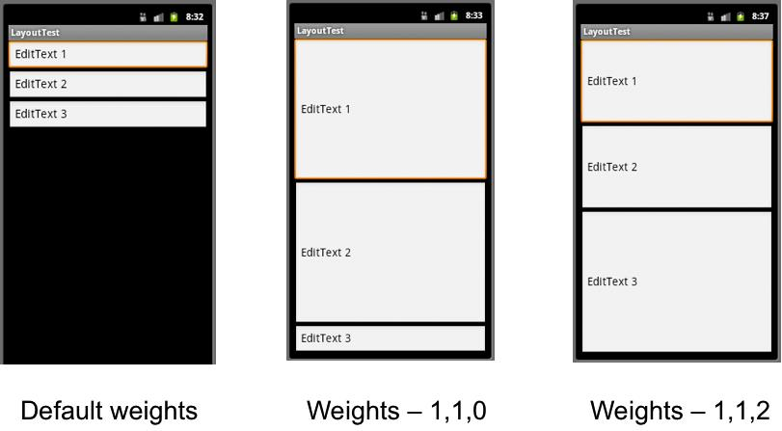
Linear Layout: Layout Weight
android:layout_weight indicates how much of the extra space in the LinearLayout will be allocated to the view. The bigger the weight the larger the extra space given to that widget.
Use 0 if the view should not be stretched

Slide 12
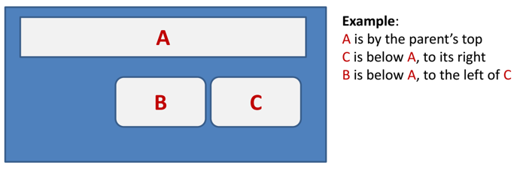
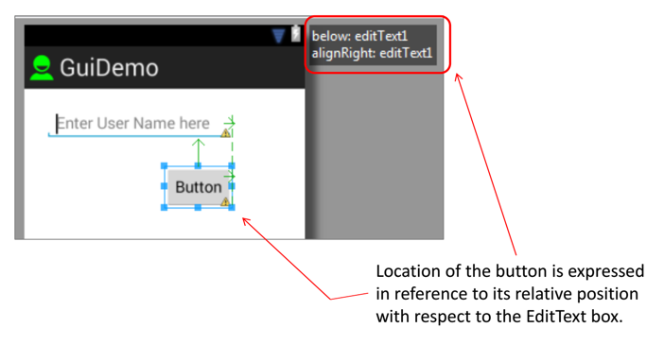
Relative Layout
The placement of widgets/views in a RelativeLayout is based on their positional relationship to other widgets in the container and the parent container.

Slide 13
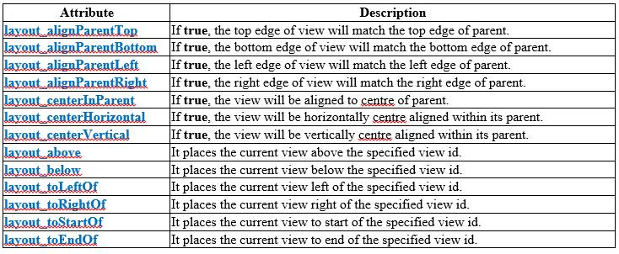
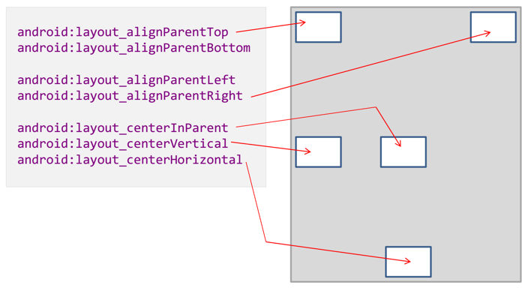
Relative Layout Attributes

Slide 14
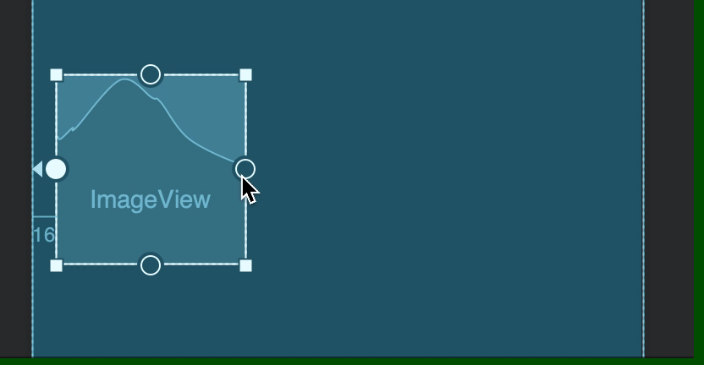
Constraint Layout
ConstraintLayout allows you to create large and complex layouts with a flat view hierarchy (no nested view groups).
It's similar to RelativeLayout in that all views are laid out according to relationships between sibling views and the parent layout.
But it's more flexible than RelativeLayout and easier to use with Android Studio's Layout Editor.
To define a view's position in ConstraintLayout, you must add at least one horizontal and one vertical constraint for the view.

Slide 15
Constraint Layout vs Relative Layout
Flat View Hierarchy (Constraint) vs Nested View Groups (Relative)
Better performance for Constraint Layout
Drag and Drop (Constraint) vs Hard-Code (Relative)
With RelativeLayout is difficult for GUI builder to handle drag-drop and probably you will have to dig inside the XML code to get things done.
But in ConstraintLayout have an option to constraint applying by the use of Blueprint and Visual Editor tool which makes it easy to design a page.
Re-computing size and position
Since Constraint layout doesn’t use any nested loop there is no need for re-computation
But Relative layout might have a lot of nested loops so re-computation becomes an absolute necessity

Slide 16
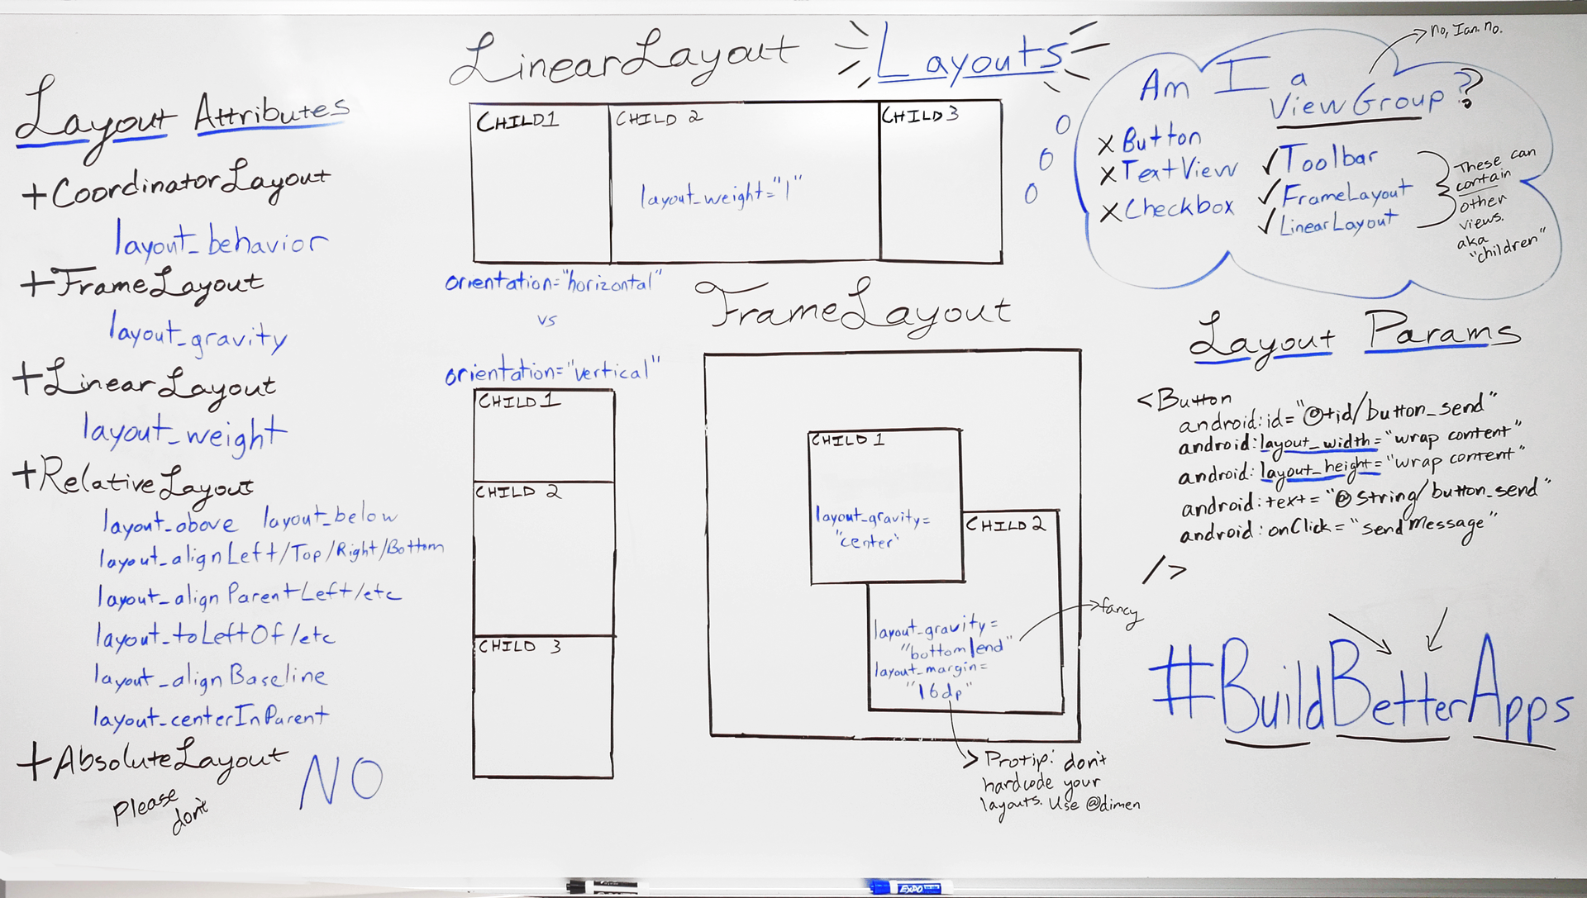
Layout Summary

Slide 17
THANK YOU

